Slide 1
COVID-19 Update
November 2023
Professor Adrian Esterman
Chair, Biostatistics and Epidemiology
University of South Australia

Slide 2
Conflicts of interest
I have no conflicts of interest

Slide 3
I will be covering
Where we are at with the current COVID wave
Latest vaccine news
Latest study on antivirals
The NICE Long Covid guidelines

Slide 4
The state of
Australia’s
COVID
statistics

Slide 5
COVID reporting
Jurisdiction | Frequency | Comment
ACT | Weekly
NSW | Weekly | ED presentations only
NT | DHAC
Qld | DHAC | Weekly case numbers
SA | Weekly | Deaths monthly
Tas | Weekly | Case numbers only
Vic | Weekly | Hospitalisations only
WA | Weekly

Slide 9
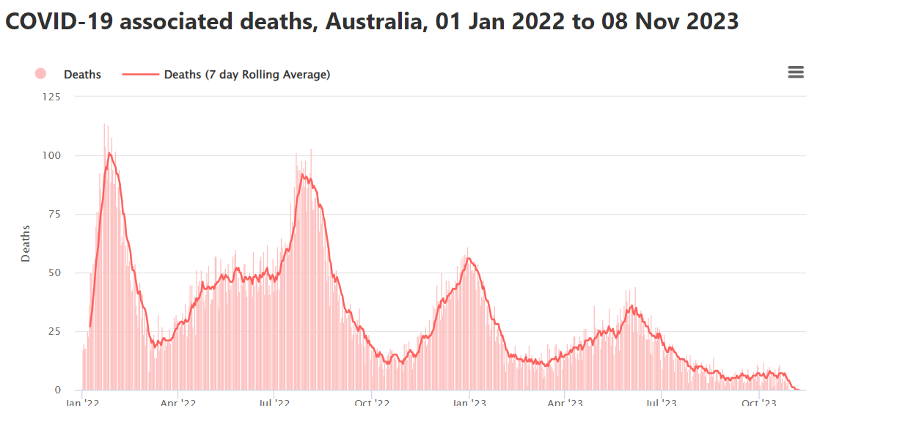

Slide 10
South Australia

Slide 14
Effective reproduction number (Reff)
If Reff > 1, epidemic continues to grow
If Reff = 1, case numbers stay constant
If Reff < 1, epidemic dies out

Slide 16
Not published
this week!

Slide 18
The Australian situation
The Australian situation

Slide 19
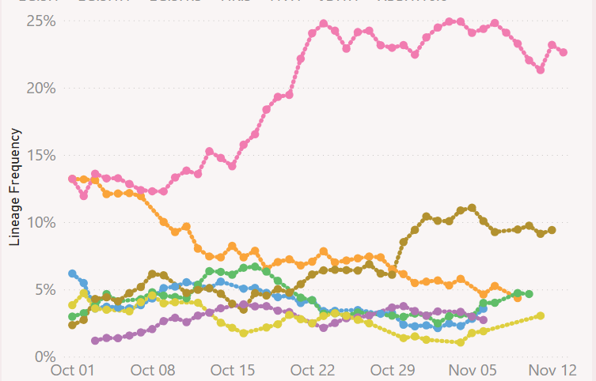
Australia Sequences (%)
HK.3
HV.1
E.G.5.1.3
EG.5.1.1
EG.5.1
JD.1.1
XBC.1.3
https://github.com/Mike-Honey/covid-19-genomes#readme

Slide 20
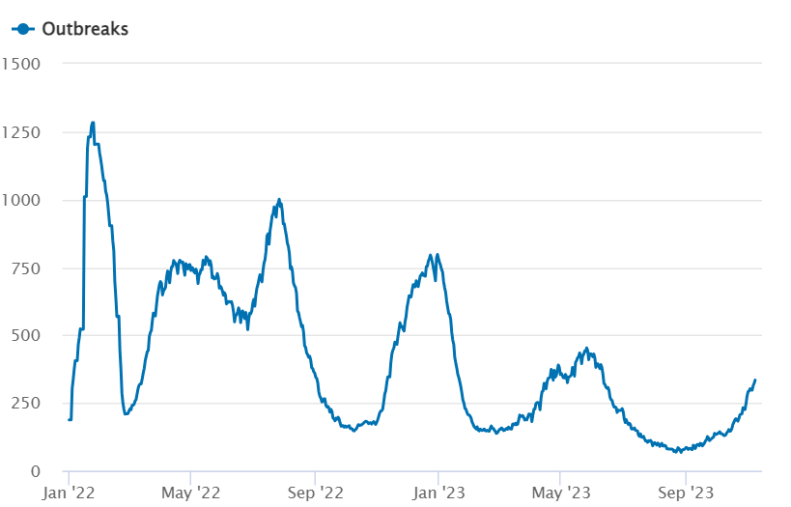
Australia - daily COVID-19
active outbreaks in aged care homes
Only 45% of aged
care residents up
to date with vaccination
334
https://www.health.gov.au/health-alerts/covid-19/case-numbers-and-statistics?language=und#covid19-case-notifications

Slide 21
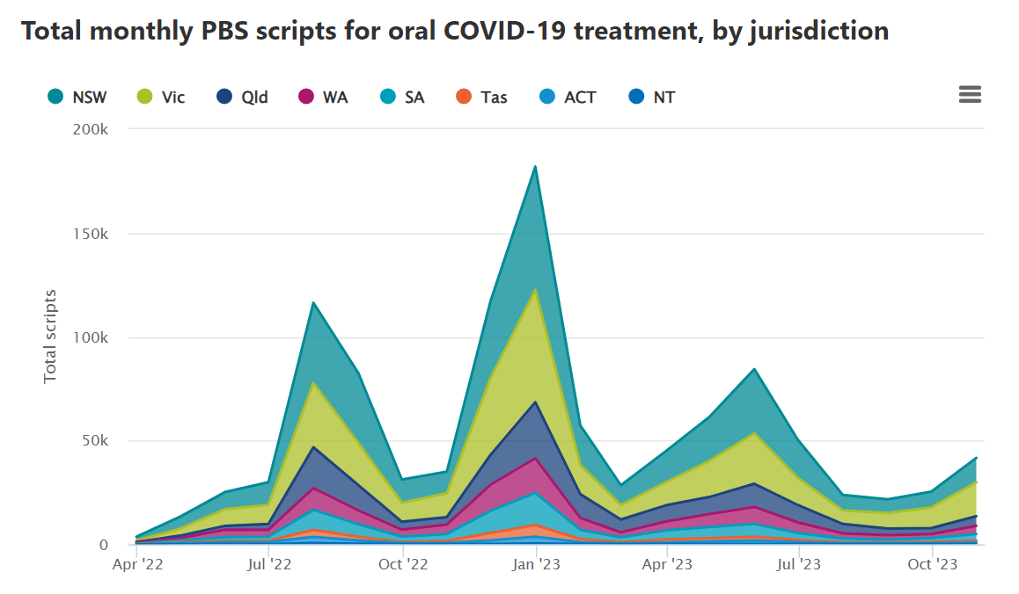

Slide 22
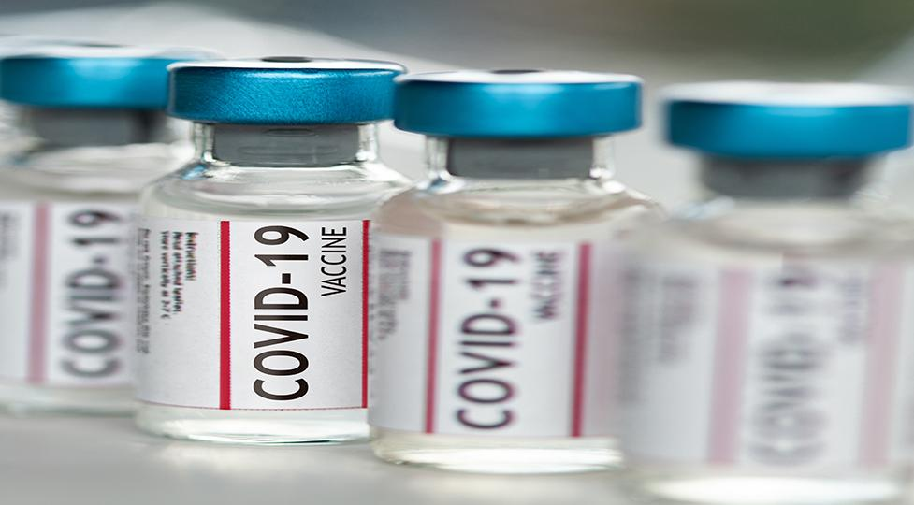

Slide 26
New monovalent vaccines
Based on XBB.1.5 recombinant subvariant
Pfizer (5-11) available 11 December
Pfizer (12+) available 11 December
Moderna (12+) available 11 December
Novavax available January/February

Slide 27
Kraken
Eris
Pirola
Pfizer
pre-clinical
Mice and primates

Slide 28
Moderna
clinical

Slide 29
Neutralizing Responses in Macaques: Primary Vaccination Bivalent BA.5 Vaccine and Boost with XBB.1.5
Boosting with XBB.1.5 induces robust neutralizing responses against selected emerging XBB subvariants
Bivalent Primary and XBB.1.5 Booster Dose
N = 4-5

Slide 30
Novavax uses moth cells to make spike proteins
Researchers select genes that create spike protein
Researchers put the genes into a baculovirus
The baculovirus infects moth cells and replicates
Moth cells create spike proteins
Researchers extract and purify the spike proteins

Slide 31
Novavax uses a Matrix-M adjuvant
It is based on a saponin extracted from the soapbark tree (Quillaja saponaria). The soapbark extract encourages immune cells to activate, generating a more potent immune response.

Slide 32
Novavax efficacy
Very similar efficacy against infection and severe illness to the mRNA-based vaccines
Fewer side-effects

Slide 33
Novavax Vaccine for Individuals ≥12 years
Presentation | Transportation & Storage
19 multidose vials per carton 10 doses of 0.5mL per dose | Stable at 2°C to 8°C 9-month shelf life Use within 12 hours of first puncture

Slide 34
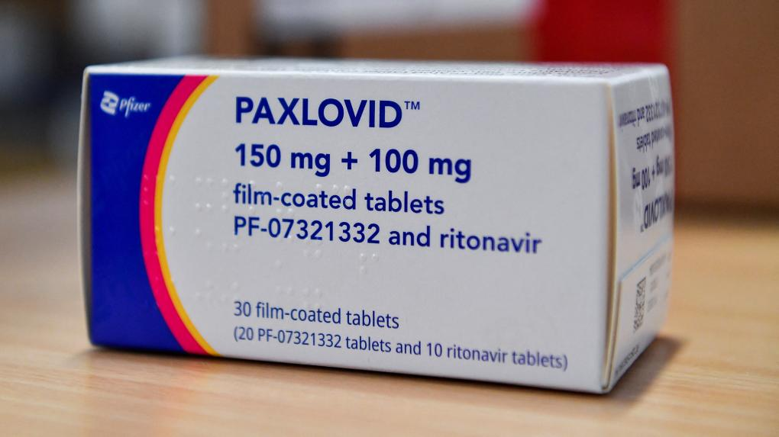

Slide 35
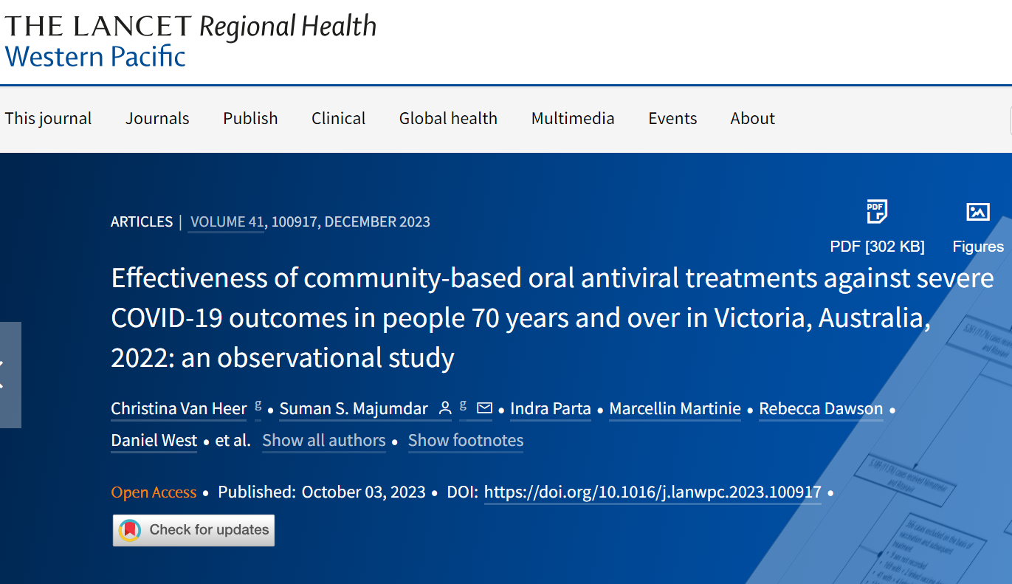

Slide 36
Retrospective cohort data linkage study
Notified COVID-19 cases
Vaccination records
Inpatient records
Death records
Oral antivirals prescription data

Slide 37
Outcomes
COVID-19 associated mortality due to any cause within 35 days from a COVID-19 diagnosis
COVID-19 associated hospitalisation due to any cause within 35 days from a COVID-19 diagnosis

Slide 38
Mortality analysis
Oral antivirals | None | Molnupiravir | Paxlovid
N | 13,721 | 19,962 | 5,250
Age | 77 | 78 | 76
Female (%) | 52 | 56 | 56
4 doses vaccine (%) | 60 | 75 | 78
Died (%) | 3.4 | 1.7 | 0.6
Odds of death | 1.00 | 0.45* | 0.27*
* p<0.0001

Slide 39
Hospitalisation analysis
Oral antivirals | None | Molnupiravir | Paxlovid
N | 10,637 | 15,673 | 4,823
Age | 75 | 77 | 75
Female (%) | 50 | 54 | 57
4 doses vaccine (%) | 61 | 75 | 80
Hospitalised (%) | 1.7 | 1.2 | 1.0
Odds of hospitalisation | 1.00 | 0.71* | 0.60**
* p=0.001 **p=0.0002

Slide 40
Timing of treatment
Cases treated within 1 day of diagnosis had a 61% reduction in the odds of death compared with 33% reduction for a delay of 4 or more days

Slide 41
Long COVID

Slide 42
https://www.nice.org.uk/guidance/ng188/resources/covid19-rapid-guideline-managing-the-longterm-effects-of-covid19-pdf-51035515742

Slide 43
NICE guidelines
Give patients diagnosed with COVID-19 info and advice on:
Most common ongoing symptoms
How to self-manage
Who to contact if worried

Slide 44
NICE guidelines
Compared to people who are unvaccinated for COVID-19, two doses plus a booster or two doses alone of COVID-19 vaccine given to people prior to SARS-CoV-2 infection may reduce the occurrence of long COVID at 12 weeks

Slide 45
NICE guidelines
Common symptoms include:
Respiratory
Cardiovascular
Generalised (fatigue, fever, pain)
Neurological
Gastrointestinal
Musculoskeletal
ENT
Psychological

Slide 46
NICE guidelines
Use a multidisciplinary approach to guide rehabilitation, including physical, psychological, psychiatric and rehab aspects of management.

Slide 47
Any good news?
Australian CDC signed off by Health Ministers
10 November 2023
“Working together to improve the timely access and sharing of consistent data, information, and advice nationally”

